Slide 1
Car Rental Service
By: Malek, Ghaith, Fawwaz And Saleh

Slide 2
Project overview
Car rental website
Reviews & Ratings

Slide 3
Database Schema
6 tables
Login_info, Customers, Owned_cars, Rentals_history, Currently_Rented and Locations

Slide 4
Login_info
3 Attributes
Email, Password, CustID
Primary Key: CustID

Slide 5
Customer
11 Attributes
CustID, Fname, Lname, License_class, License_number, License_issue, License_expiry,
Date_of_birth, Sex, Car_rented
Primary Key: CustID
Foreign Keys: CustID references Login_info.CustID,
Car_Rented references Currently_rented.RentalID

Slide 6
Owned_cars
14 Attributes
CarID, LocationID, Make, Model, Year, Mileage, MPG, Color, Transmission, Cylinders, Litres, Price, No_of_seats, Body_type
Primary Key: CarID
Foreign Key: LocationID references Locations.LocationID

Slide 7
Rentals_History
6 Attributes
RentalID, CarID, CustID, Pickup_date, Days_Rented, Review, Rating
Primary Key: RentalID
Foreign Keys: CarID references Owned_cars.CarID
CustID references Customers.CustID

Slide 8
Currently_Rented
3 Attributes
RentalID, Pickup_date, Return_date
Primary Key & Foreign Key: RentalID references Rentals_History.RentalID

Slide 9
Locations
6 Attributes
LocationID, Location_name, Street, City, Province, Postal_code
Primary Key: LocationID

Slide 10
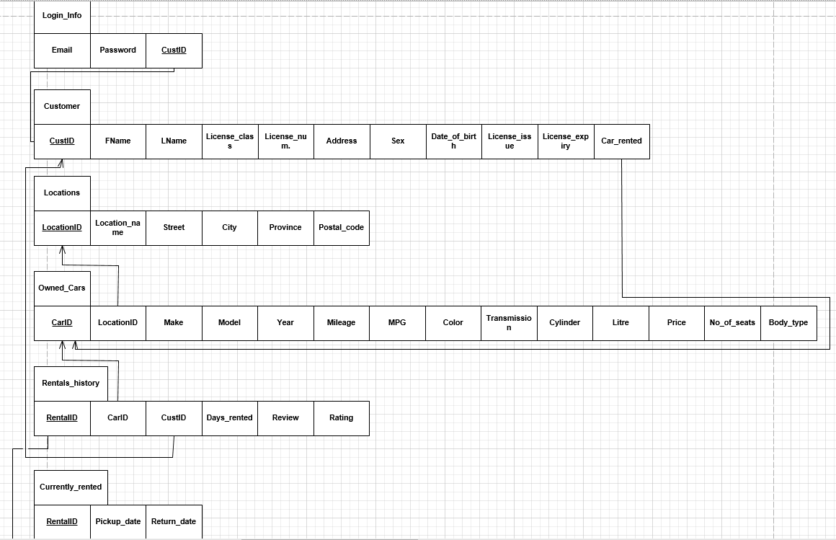
Relational Schema

Slide 11
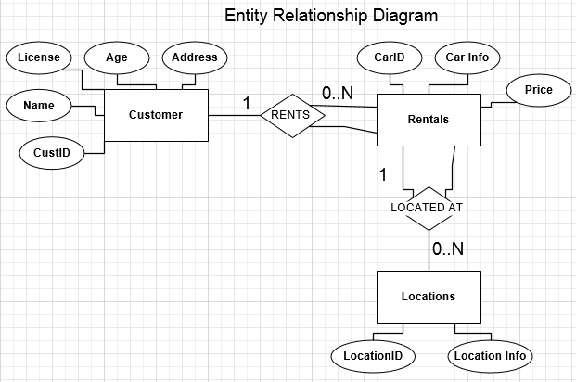
Entity Relationship Diagram

Slide 12
Website Features - User
Search for vehicles by location
View all car related details
View your rental history
Enter rating and review for past rentals
Filter cars by color, body type, number of seats
View online rating of car
Rent cars

Slide 13
Website features - admin
View rental history of all, or specific user
Enter new vehicle into the database to be displayed on site

Slide 14
External api calls
EDMUNDS CAR API used to get data about vehicle when enter into database such as: transmission, cylinders, litres, mpg
Used to display online rating of vehicle

